Slide 1
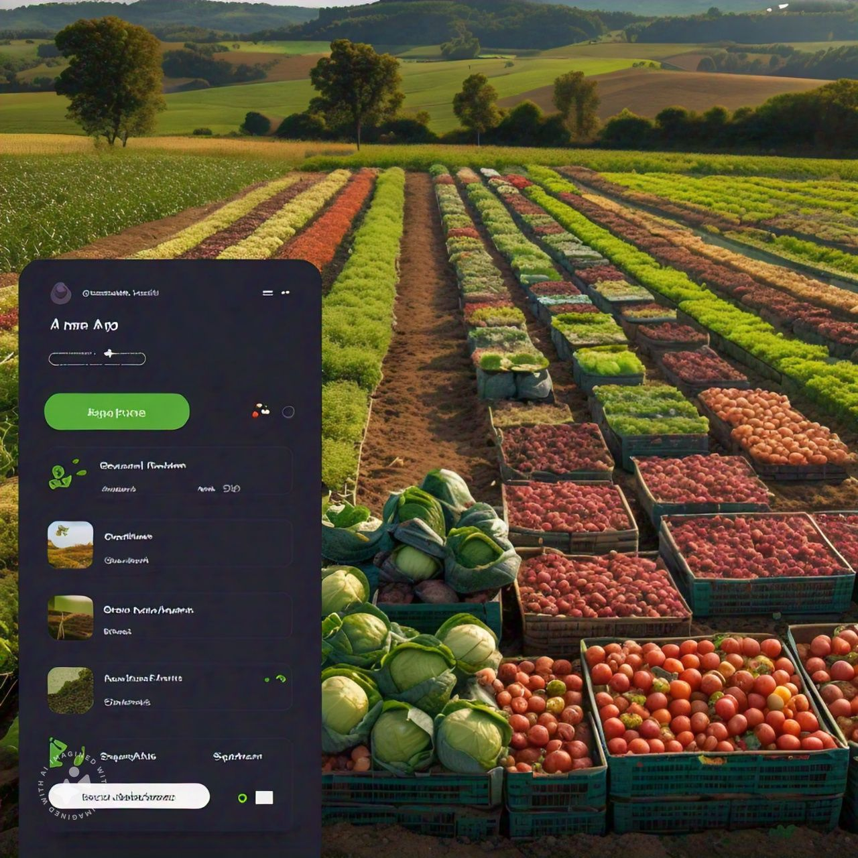

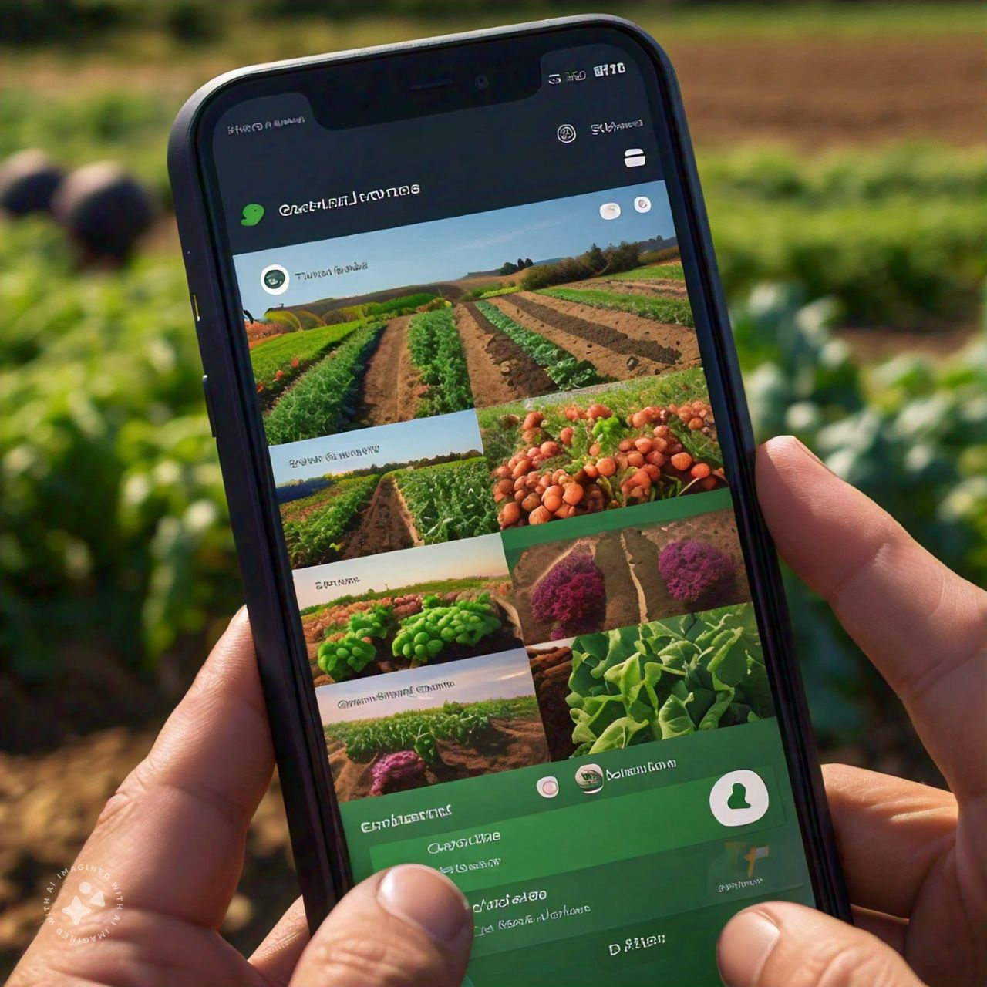
Aavishkar Research Competition: 2024-25
(IDEA CHA AAVISHKAR)
Category: ENGENEARING AND TECHNOLOGIES .
Level: UG.
Crop Selling Application For Farmers
100,000
Problems:
Farmers struugle to find Buyers for their harvested crops.
Limited market access for small-scale farmers
low prize for farmers production
limited economic growth opportunities for farmers
Objectives :
Improve farmers bargaining power and profit margins.
Empower small-scale farmers to reach broader markets.
Farmers upload their harvested crop,including images description pricing.
100,000
100,000
Solution:
Benifits for Farmers:
Develop a user-friendly Mobile app connecting farmers directly with busnessmen for crop sales.
Direct sales with better profit margins .
Reduced tranportation costs.
Enhance visibility and reach.
Promotion of local buisnesses.
Integrated Google maps for location sharing for farmers crops from their farms.
farmers can list their crops and businessman can browsde purchase.
Benifits for Buisnessmen:
Access for fresh produced directly from farms.
Direct communication with farmers.

